Slide 1
FUBSWRJUDSKB
WKH DUW RI KLGLQJ D PHVVDJH LQ SODLQ VLJKW

Slide 2
CRYPTOGRAPHY
THE ART OF HIDING A MESSAGE IN PLAIN SIGHT

Slide 3

WHAT IS CRYPTOGRAPHY?

Slide 4
Cryptography?
It is the simple transformation of readable text into gibberish.
Example: Wkh Zdonlqj Ghdg = The Walking Dead
The gibberish text is called cipher-text.
The original text is called plain-text.
The process of transforming the plain-text to cipher-text is called enciphering or encrypting.
The process of transforming the cipher-text to plain-text is called deciphering or decrypting.

Slide 5
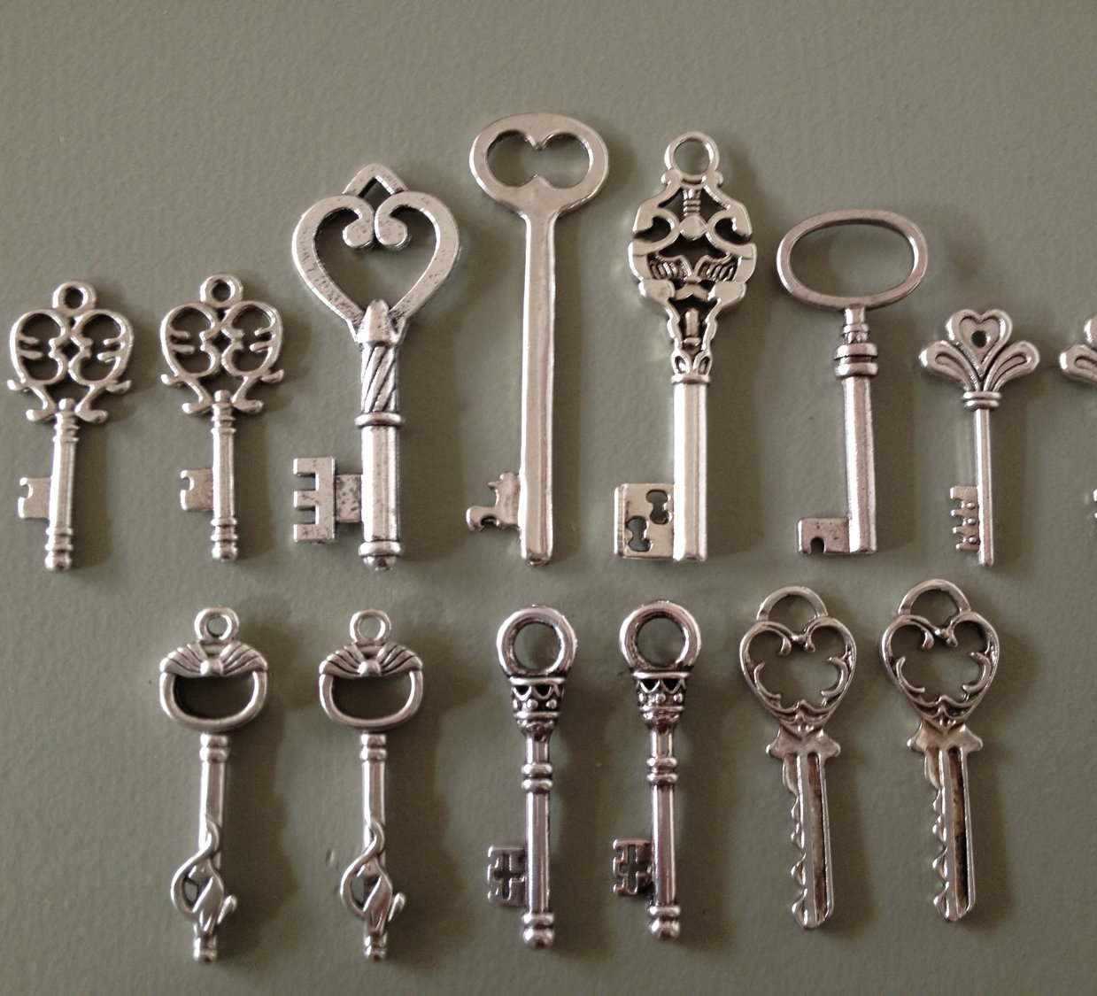
KEYS for Cryptography
Notes:
Like doors and locks have keys. So does cryptography! I stay in Brooklyn with 2 other friends of mine. There is a door to our house. We need to protect our house from unwanted entry, so we lock it with a key. Now this key is shared with my roommates and I ( we each have a copy of the key s we can come and go as we please.) Keys in cryptography word the same way! Keys are shared between people who want to talk so they are the ones who will be able to decipher the gibberish!

Slide 6
Types of Crypto Techniques
There are 2 ways to hide text:
Transposition- Interchanging letter positions.
Substitution- Replacing letters with a different letter.
Example: If D=M and A=O….
DAD
…Becomes…
MOM

Slide 7
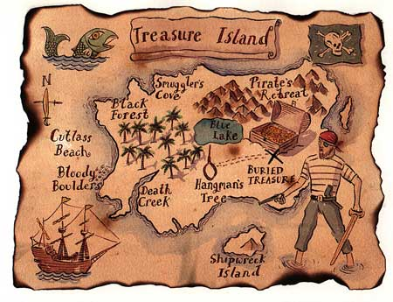
What is an algorithm/cipher?
It is like an instruction or set of instructions to reach a goal.
IN GENERAL…. It is like a Map to buried treasure.
Pic credits: reddit

Slide 8
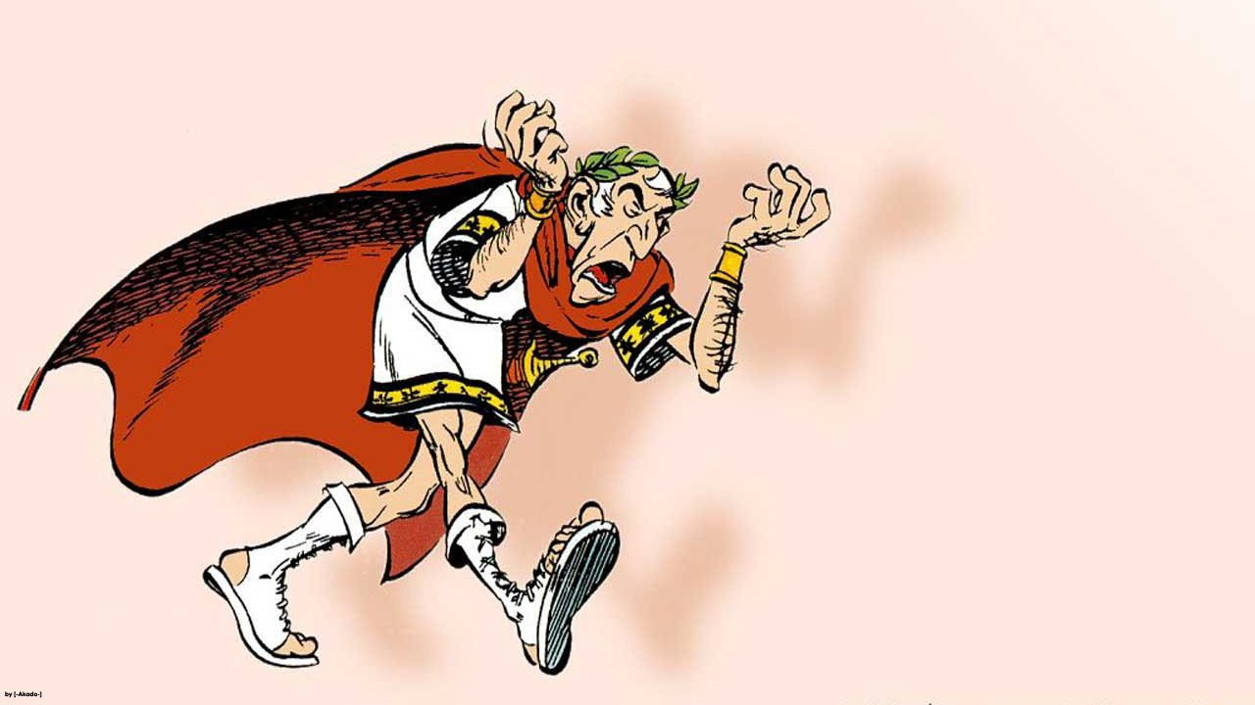
Caesar Cipher
CAESAR CIPHER

Slide 9
What is the Caesar Cipher?
“IT IS A SHIFT OF LETTERS FROM THEIR ORIGINAL POSITION”
Shifts can have a value of 0-25, where 0 is no change from the original alphabet, and 25 is a full rotation (A=Z).
So, why did Caesar do that?
Well, because….
JULIUS CAESAR becomes MXOLXV FDHVDU. So sending messages to his legions would be really safe!

Slide 10


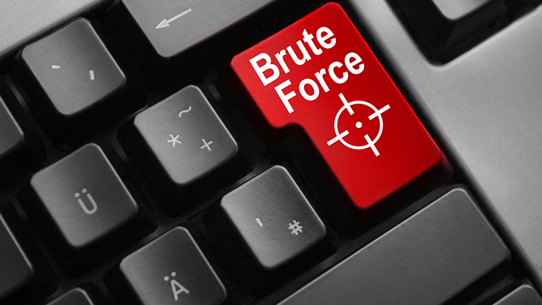
Why Caesar Cipher is a bad choice?
The Caesar cipher uses a simple shift. Since there are only 26 letters in the alphabets, the cipher can easily be brute forced. In other words, it is possible that someone can try all possibilities of decryption.

Slide 11
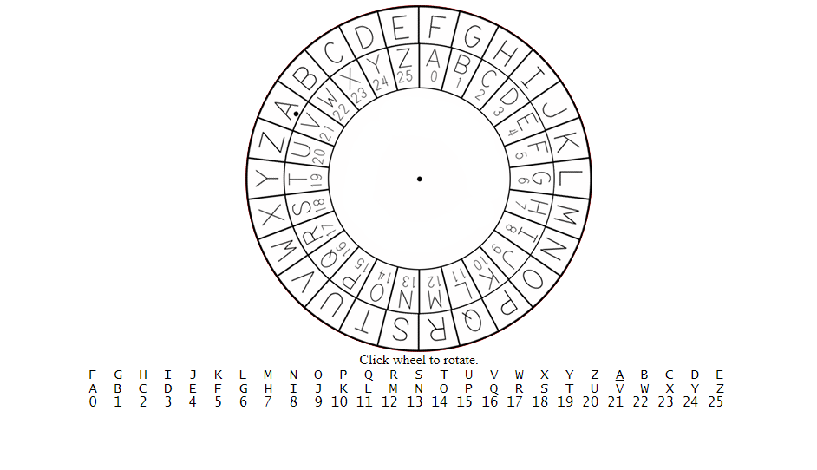
Let’s Test This!
http://inventwithpython.com/cipherwheel/

Slide 12

Demo (Enciphering)
S u s s y (A=Z)
R t r r x

Slide 13
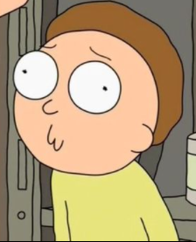
Demo (Deciphering)
W y b d i (A=K)
M O R T Y

Slide 14
Practice
Encrypt the following phrases with the key and say the answer.
Mass Effect (A=M)
Legend of Zelda (A=F)
Ymee Qrrqof
Qjljsi tk Ejqif

Slide 15
Practice (cont.)
Decrypt the following phrases with the key and say the answer.
Xibv Kti Utmmexl hy Ablmhkr (A=T)
Jvyhspul (A=H)
Epic Rap Battles of History
Coraline

Slide 16
Practice (cont.)
Write a program that accepts a string as an input and prints the ascii values of each character as the output.
Append the string with it’s ascii values and print the new string.
Example Input: “CAR”
Output- 67 65 82
“The new String is: C67A65R82”
Notes:
def convAscii(str):
print("The new string is:") #use this print statement has a header
for char in str:
conversion = ord(char)
print(char, conversion)
text = input("Enter a word to encrpyt:")
for char in text:
print(char, ord(char), sep='', end='')
def convASCII(text):
result = []
for char in text:
result.append(str(ord(char)))
print(' '.join(result))
new_str = []
for i in range(len(result)):
char = text[i] + str(result[i])
new_str.append(char)
print("Your new string is",''.join(new_str))

Slide 17
Practice (cont.)
Write a program that accepts a line/ sentence as input and prints the lines after making all characters in the sentence capitalized.
Hint: Use ord and ASCII table.
chr(ord(‘a’)-32) = A
Notes:
sentence = input("Enter a sentence in lowercase letters only: ")
for char in sentence:
if ord(char) > 96 and ord(char) < 123:
print(chr(ord(char)-32), sep='', end='')
else:
print(char, sep='', end='')
print(end='\n')
def capitalize(sentence):
new_str = []
for char in sentence:
if ord(char) > 96 and ord(char) < 123:
new_str.append(chr(ord(char)-32))
else:
new_str.append(char)
print(''.join(new_str))

